Slide 1


Automate yourself – Service Management like a Boss
Kurt van Hoecke Stijn Callebaut

Slide 2
Automate yourself
and become the boss…

Slide 3
Session objectives
Automation added value
Identify key elements for automation
Demo the PowerShell role in automation
People, processes and product

Slide 4
Automation,
PowerShell!!
Automation engine
Provision <whatever you want>
Automation framework

Slide 5
“Characteristics” of the automation
On-demand self-service
Flexible requests
Deployment based on input
Standard offerings
Company standards applied in automation
Applications installed
Processes are integrated
Approval / Deployment / Notifications

Slide 6
Provisioning in Azure GUI Style
Let’s look how you can do this via the GUI. Discovering the new portal.

Slide 7


Slide 8
Recap
On-demand self-service
Flexible requests
Deployment based on input
Standard offerings
Company standards applied in automation
Applications installed
Processes are integrated
Approval / Deployment / Notifications

Slide 9
Provisioning in Azure The PowerShell way
Hey, we can do this from PowerShell ISE!

Slide 10
The Value of Automation with PS
Capability
Value
Orchestrate tasks across systems and datacenters
Improve service performance and availability
Standardize deployment processes
Optimize resources and get consistent outcomes
Automate large volume and highly repetitive tasks
Lower costs & reduce manual, error prone activities
Integrate System Center with 3rd party tools
Simplify data center management

Slide 11


Slide 12
Recap
On-demand self-service
Flexible requests
Deployment based on input
Standard offerings
Company standards applied in automation
Applications installed
Processes are integrated
Approval / Deployment / Notifications
Clicks in portal are automated

Slide 13
Provisioning in Azure Scaling the automation (SMA)
PowerShell in the workflow engine(s)

Slide 14
The Value of SMA in automation
Capability
Value
Orchestrate automation across systems and datacenters
Improve service performance and availability
Standardize deployment processes
Configuration
Application and roles
Optimize resources and get consistent outcomes
Even on applications level
Automate large volume and highly repetitive tasks
Lower costs & reduce manual, error prone activities
3rd party integration via PS modules
Simplify data center management across toolset

Slide 15
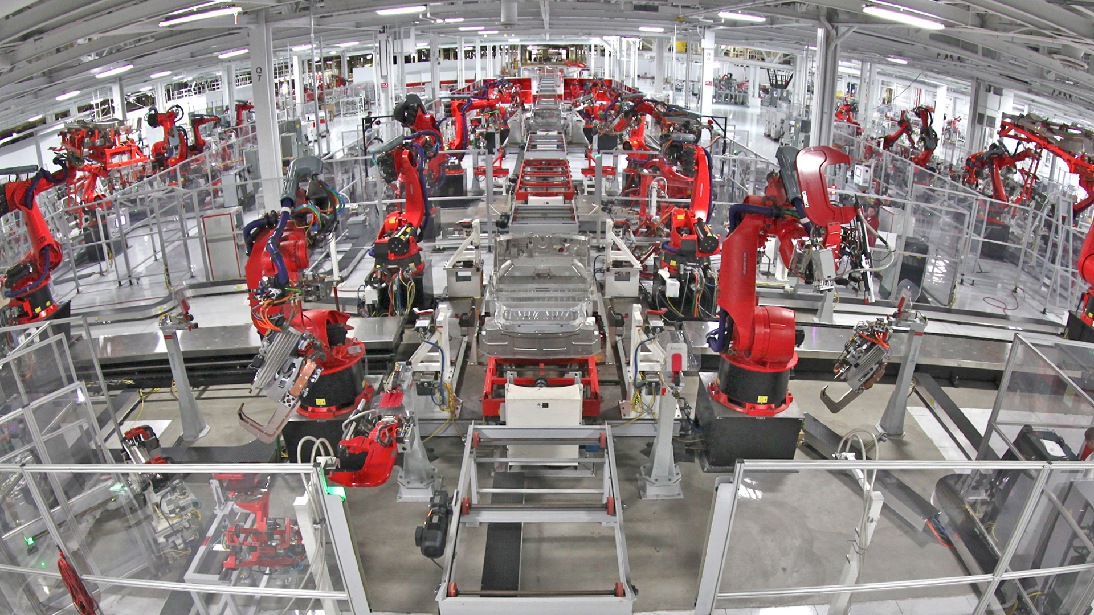

Slide 16
Recap
On-demand self-service
Flexible requests
Deployment based on input
Standard offerings
Company standards applied in automation
Applications installed
Processes are integrated
Approval / Deployment / Notifications

Slide 17
Service Requests, Process integrated automation
Process, People and Product – 3P approach to quality

Slide 18
The Value of Process integration
Capability
Value
Self-service portal with published company requests
Company requests can be published with own standards
Automation integrated in the process
Automated provisioning with consistent outcomes
Service Request Management
Request are measures, notifications are send based on process
End-to-end configurable solution
Company defines own standards

Slide 19
System Center Service Manager
Request offerings
Service offering
Offering created by IT service provider that consumers request using the service catalog
Work item used to identify and classify standard IT services
Contains one or more request offerings
Based on a template
Templates
The service catalog
Minimize data entry by providing default values
Standardize processes

Slide 20


Slide 21


Recap
On-demand self-service
Flexible requests
Deployment based on input
Standard offerings
Company standards applied in automation
Applications installed
Processes are integrated
Approval / Deployment / Notifications

Slide 22
Session objectives
Automation added value
Identify key elements for automation
Demo the PowerShell role in automation
People, processes and product

Slide 23
The future is…NOW
Azure automation ( = SMA)
Azure Stack ( = the on prem Azure portal)
Azure hybrid workers ( = SMA runbook worker)

Slide 24
Belgiums’ biggest IT PRO Conference

Slide 25

Be the first to know
Follow Technet Belgium
@technetbelux
Subscribe to the TechNet newsletter
aka.ms/benews

Slide 26

Thank you!

